Slide 1
Blocks
UVA 10559
3 seconds

Slide 2
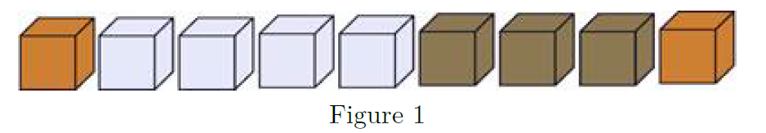
Problem Descriptions(1/4)
Some of you may have played a game called ‘Blocks’.
There are n blocks in a row, each box has a color.
Here is an example: Gold, Silver, Silver, Silver, Silver, Bronze, Bronze, Bronze, Gold.

Slide 3
Problem Descriptions(2/4)
If some adjacent boxes are all of the same color, and both the box to its left (if it exists) and its right (if it exists) are of some other color, we call it a “Žbox segment”.
There are 4 box segments. That is: gold, silver, bronze, gold. There are 1, 4, 3, 1 box(es) in the segments respectively.

Slide 4
Problem Descriptions(3/4)
Every time, you can click a box, then the whole segment containing that box DISAPPEARS.
If that segment is composed of k boxes, you will get k╳ k points. for example, if you click on a silver box, the silver segment disappears, you got 4╳ 4 = 16 points.
Now lets look at the picture below:

Slide 5
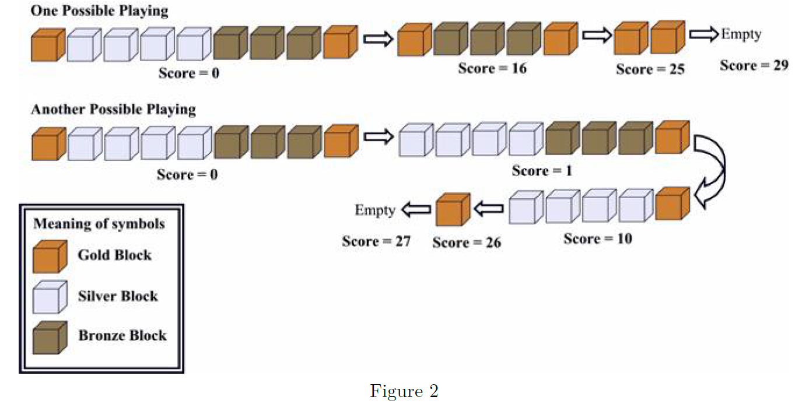
Two Solutions (4/4)

Slide 6
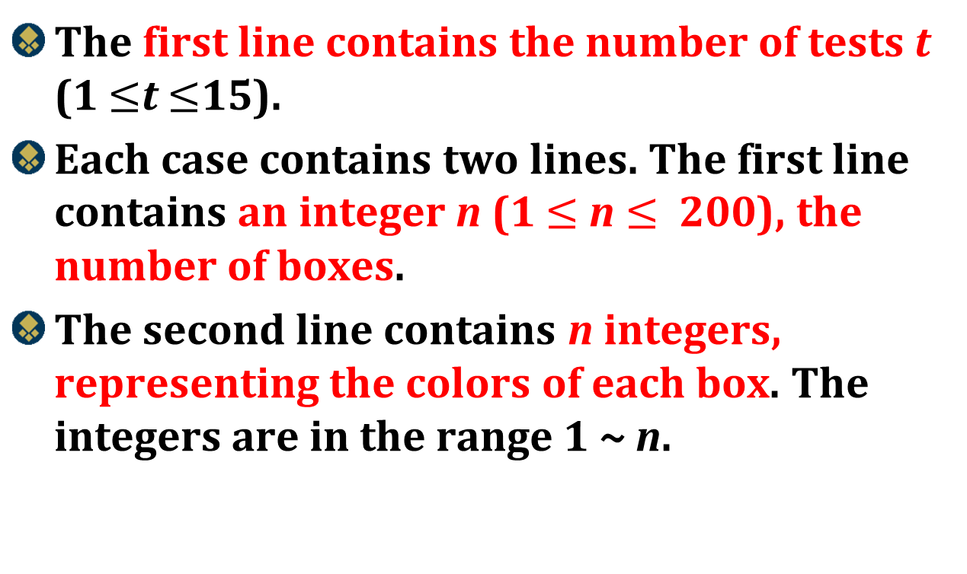
Input
The first line contains the number of tests t (1 $≤$t $≤$15).
Each case contains two lines. The first line contains an integer n (1 $≤$ n $≤$ 200), the number of boxes.
The second line contains n integers, representing the colors of each box. The integers are in the range 1 ~ n.

Slide 7
Output
For each test case, print the case number and the highest possible score.

Slide 8

Example
Number of test cases
2
9
1 2 2 2 2 3 3 3 1
1
1
Case 1: 29
Case 2: 1
Number of boxes
Color of each box

Slide 9
Dynamic Programming
Prof. Shin-Hung Chang

Slide 10
Dynamic programming
It is used, when the solution can be recursively described in terms of solutions to subproblems (optimal substructure)
Algorithm finds solutions to subproblems and stores them in memory for later use
More efficient than “brute-force methods”, which solve the same subproblems over and over again

Slide 11
What’s the difference Divide and Conquer Dynamic Programming?

Slide 12
Divide and Conquer
Top-down Design
Dynamic Programming
Button-up Design

Slide 13

Montage Photo
Divide and Conquer
Dynamic Programming

Slide 14
Chained Matrix Multiplication
Prof. Shin-Hung Chang

Slide 15
Matrix Multiplication
Problem:A_{2x4}×B_{4x3}×C_{3x5}×D_{5x1}
What is the minimum “×” cost order to do this matrix multiplication?

Slide 16
35
(A×B×C×D)_{2x5}
(A×B×C)2x5
(B×C×D)4x1
54
27
(A×B)_{2x3}
(B×C)_{4x5}
(C×D)_{3x1}
24
60
15
A_{2x4}
B_{4x3}
C_{3x5}
D_{5x1}

Slide 17

Chained Matrix Multiplication
Suppose we want to multiply a 2 × 3 matrix times a 3 × 4 matrix as follows:
The resultant matrix is a 2 × 4 matrix
If we use the standard method of multiplying matrices, it takes three elementary multiplications to compute each item in the product
Because there are 2 × 4 = 8 entries in the product, the total number of elementary multiplication is
ixj
jxk
ixk
2×3×4

Slide 18


Consider the multiplication of the following four matrices:
There are five different orders in which we can multiply four matrices, each possibly resulting in a different number of elementary multiplications
The third order is the optimal order for multiplying the four matrices

Slide 19
找斷點的做法???
A_{i}, A_{i+1}, …, A_{j} 在某組合方式所需的純量積乘法次數為最小 (最佳)，則必存在一個k，使得A_{i}, A_{i+1}, …, A_{k} 和A_{k+1}, A_{k+2}, …, A_{j}皆為最佳。
((d_{i-1} A_{i} d_{i} A_{i+1} … A_{k}d_{k})(A_{k+1}d_{k+1} A_{k+2}d_{k+2} …, A_{j}d_{j}))
Chained Matrix Multiplication Recurrence
Optimal
Sub Optimal
Sub optimal

Slide 20
先整理一下資料
1 | 2 | 2 | 2 | 2 | 3 | 3 | 3 | 1
len
0 | 1 | 2 | 3
1 | 4 | 3 | 1
col
1 | 2 | 3 | 1

Slide 21
找斷點的做法，可行嗎???
col
1 | 2 | 3 | 1
設定 dp(l, r) 為從 index l 到 index r 代表 maximum score
$$dp\left(l, r\right)=\max{\{dp\left(l, i\right)+dp\left(i+1, r\right), for l≤i≤r}$$
l
i
r
len
0 | 1 | 2 | 3
1 | 4 | 3 | 1

Slide 22
會有甚麼問題?
設定 dp(i, j) 為從 index i 到 index j 代表 maximum score
$$dp\left(l, r\right)=\max{\{dp\left(l, i\right)+dp\left(i+1, r\right), for l≤i≤r}$$
l
i
r
l
r
len
0 | 1 | 2 | 3
1 | 4 | 3 | 1
len
0 | 3
1 | 1
col
1 | 2 | 3 | 1
col
1 | 1
1²=1
1²=1
2²=4

Slide 23

需要更細節的設定
設定 dp(i, j, k) 為從 index i 到 index j , 再加上右邊k個代表 maximum score
$$dp\left(i, j,k\right)=\max{\{???\}}$$
k
l
r
k
l
r

Slide 24


Case 1: 合併後，最右邊的一段，顏色相同
設定 dp(i, j, k) 為從 index i 到 index j , 再加上右邊k個代表 maximum score
$$dp\left(l, r,k\right)=\max{\{dp\left(l,r−1,0\right)+{(len\left[r\right]+k)}^{2}\}}$$
k
l
k
l
r
r
$$dp\left(l,r−1,0\right)$$
$${ + (len\left[r\right]+k)}^{2}$$

Slide 25

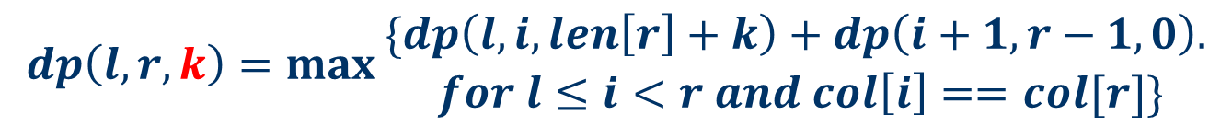

Case 2: 合併後，l 到r 中間有一個col[i]與col[r]顏色相同，可以合併
設定 dp(i, j, k) 為從 index i 到 index j , 再加上右邊k個代表 maximum score
$$dp\left(l, r,k\right)=\max{\begin{aligned}\{dp\left(l,i,len\left[r\right]+k\right)+dp\left(i+1,r−1,0\right). \\ for l≤i<r and col\left[i\right]==col[r]\}\end{aligned}}$$
k
k
l
i
r
l
i
r
$$dp\left(l,i,len\left[r\right]+k\right)$$
$$dp\left(i+1,r−1,0\right)$$

Slide 26
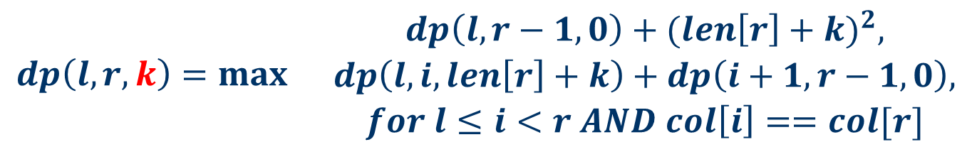
設定 dp(i, j, k) 為從 index i 到 index j , 再加上右邊k個代表 maximum score
$$dp\left(l, r,k\right)=\max{\begin{matrix}dp\left(l,r−1,0\right)+{(len\left[r\right]+k)}^{2}, \\ \begin{aligned}dp\left(l, i, len\left[r\right]+k\right)+dp\left(i+1,r−1,0\right), \\ for l≤i<r AND col\left[i\right]==col[r]\end{aligned}\end{matrix}}$$

Slide 27
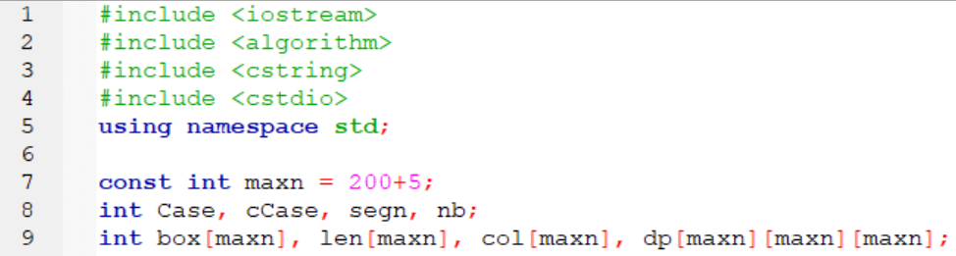
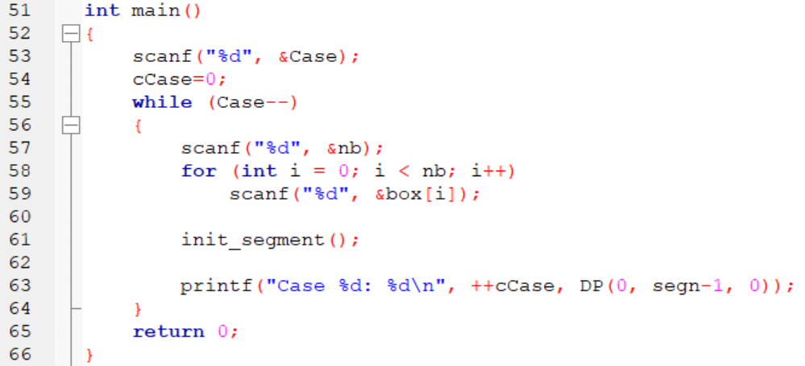

Slide 28
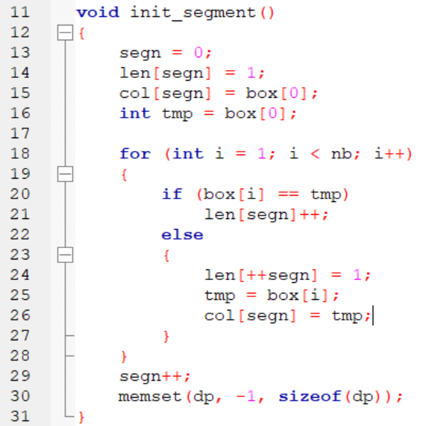

Slide 29
